Slide 1

Movie recommendation with Review Analysis System
A school project presented by Project Red Mind
BBD-ITM
Department of Information Technology
Project Guide :
Prof. Girijesh Mishra
January 15,2021

Slide 2
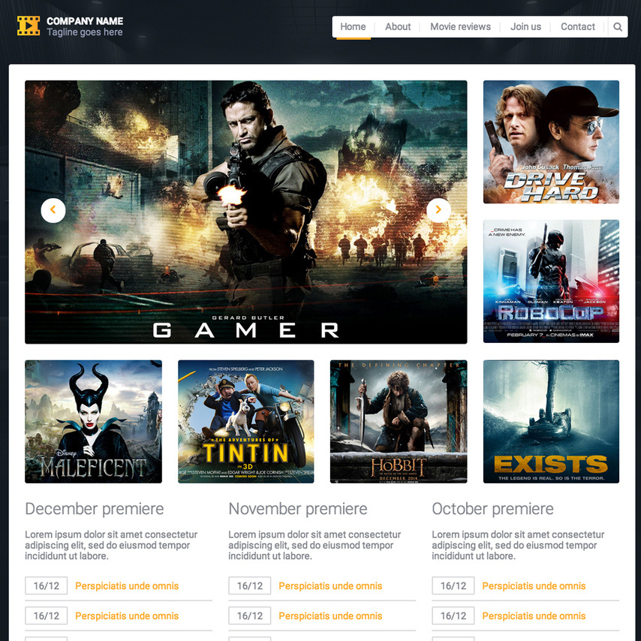
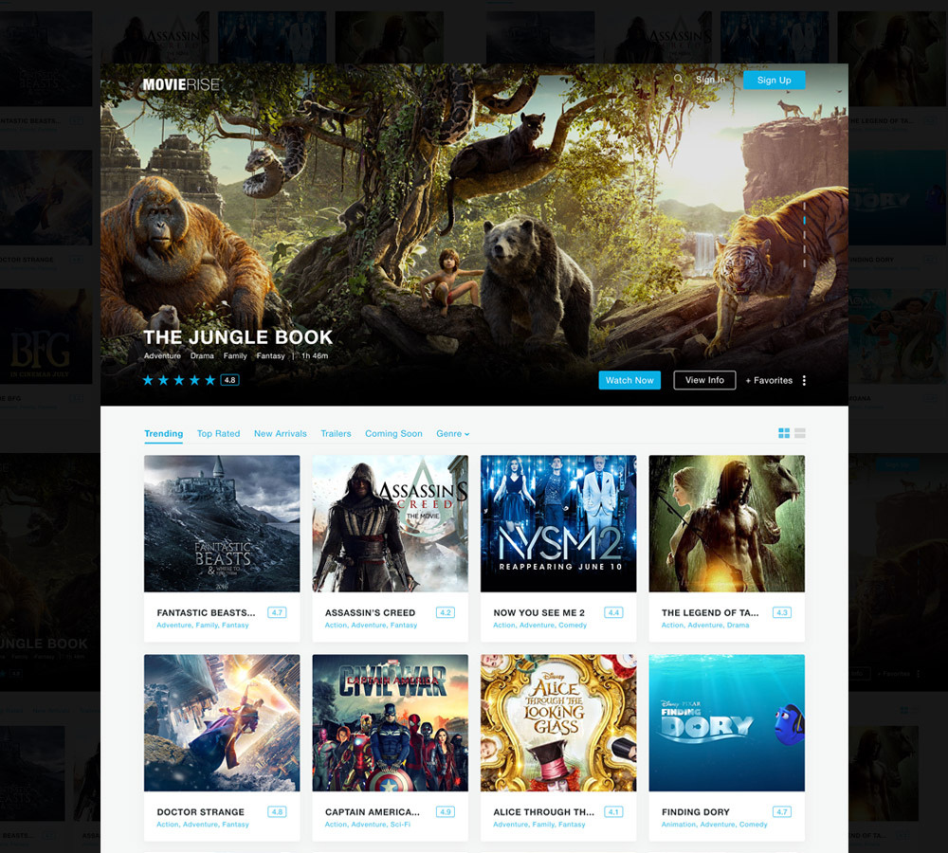
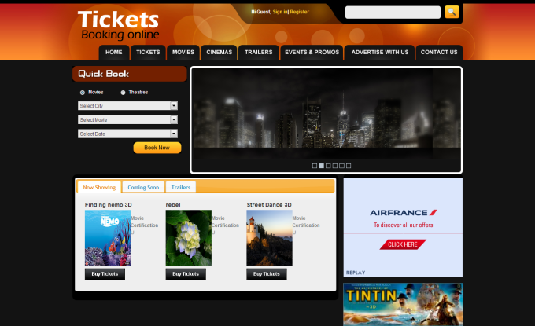
Introduction
TThis project is web-based enterprise software (website),
which provides solutions to many Online User Services(like Mask Detection System,Movie recommendation with Sentiment Analysis,
Memoji generation and much more) and to provide less time to accomplish
their work. This website is being developed for those users who need any movie
recommendation or who need to make their own Memoji and download them.
In Today’s life, the
time is less and too much work to do , those people who need to have some new
released movie recommendation, then they could use our movie recommendation
service to get all up-to-date recommendation and information about any newly released movie.
This Web application
project is very big and includes almost all aspects of User services .The complete
architecture is distributed and on-line so the management of data is done
online. To manage data like update, delete, etc. is to be developed. Here a
BBD-ITM
Department of Information Technology
Project Guide :
Prof. Girijesh Mishra
January 15,2021

Slide 3
Project Module
User
Login Module
The customer can register themselves here for free, and include details of their email and password. Further links shall be provided after registering here.
Movie
Review Module
Information based on the database present shall be displayed here, including synopsis, cast and overall critics as well as audience reviews.
Project Guide :
Prof. Girijesh Mishra
BBD-ITM
Department of Information Technology
January 15,2021

Slide 4
Admin
Control Module
In this module, the administrator maintains the User Details, Movie details and the review associated with it.
System
Design
This is the most critical factor affecting the quality of the software; the output of the phase is a designed document. This is similar to a plan or blueprint of the solution. It is the most important part of the process so we shall further be explaining it in more detail.
Project Guide :
Prof. Girijesh Mishra
BBD-ITM
Department of Information Technology
January 15,2021

Slide 5
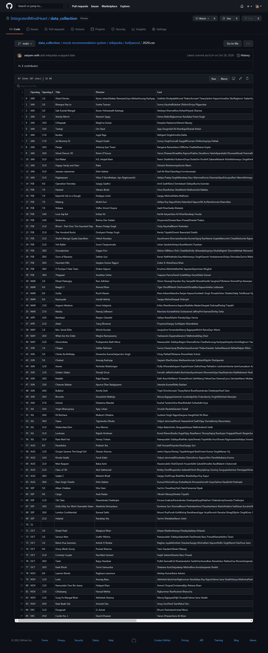
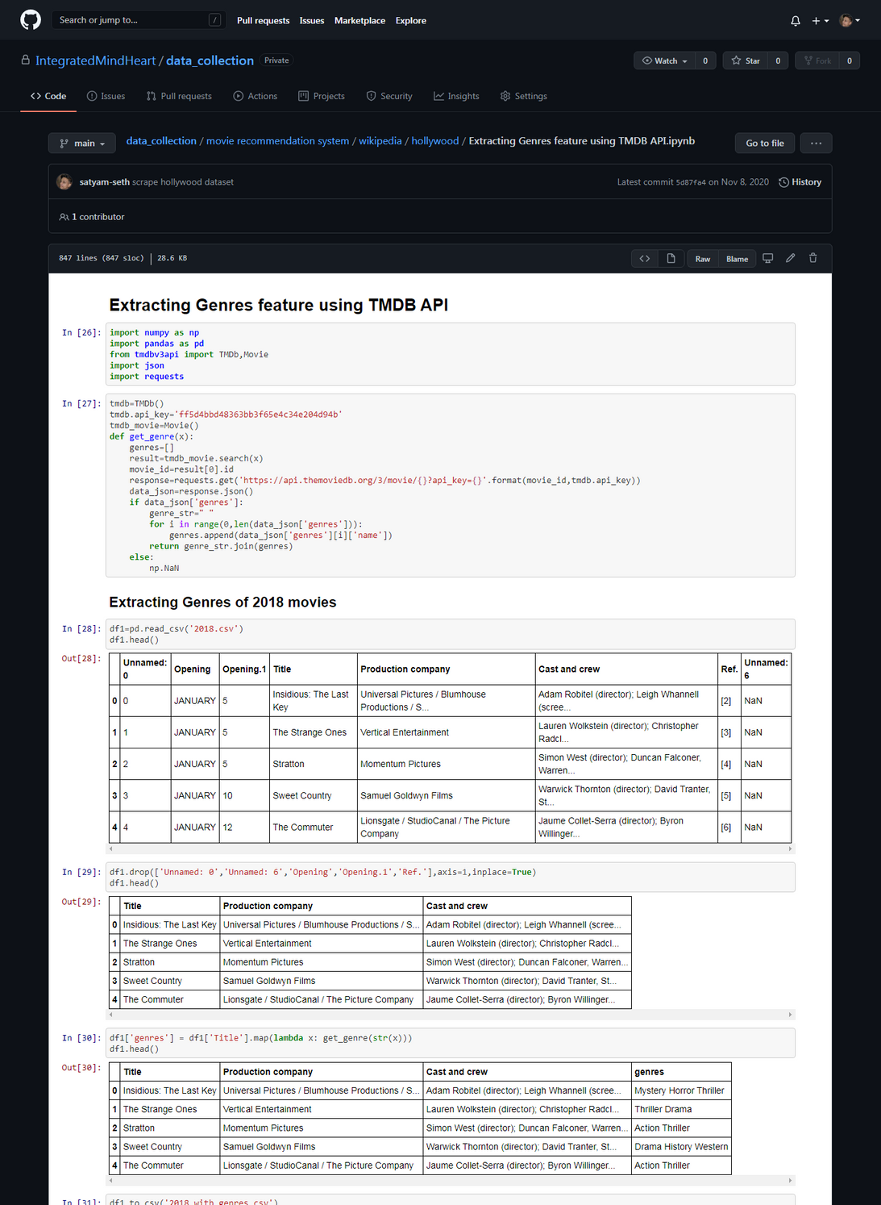
System Design
In terms of modules these can further be divided into subcategories:
Data Collection
For collecting movies data from Wikipedia we use web
scraping as a tool to achieve it–
Since one data set is not enough to collect a huge array of genres we use TMDB API to get more information
about movies-

Slide 6
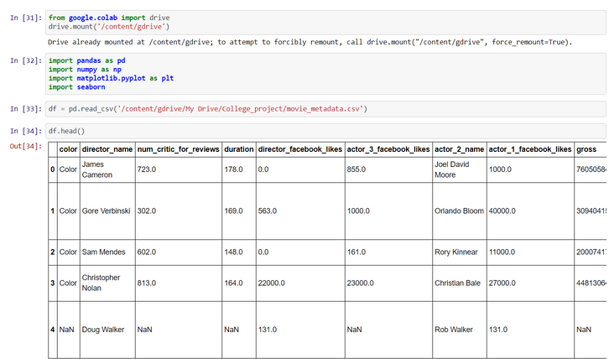
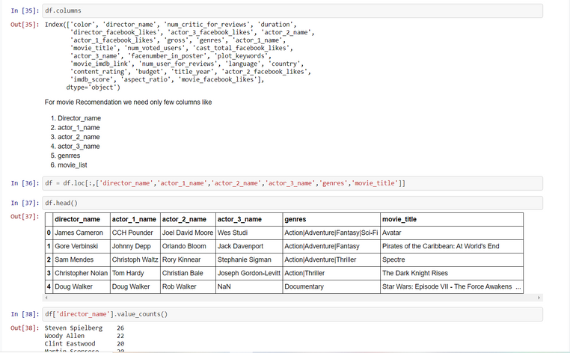
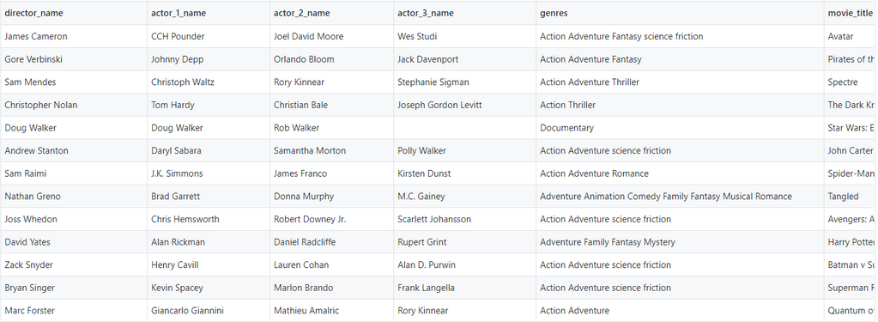
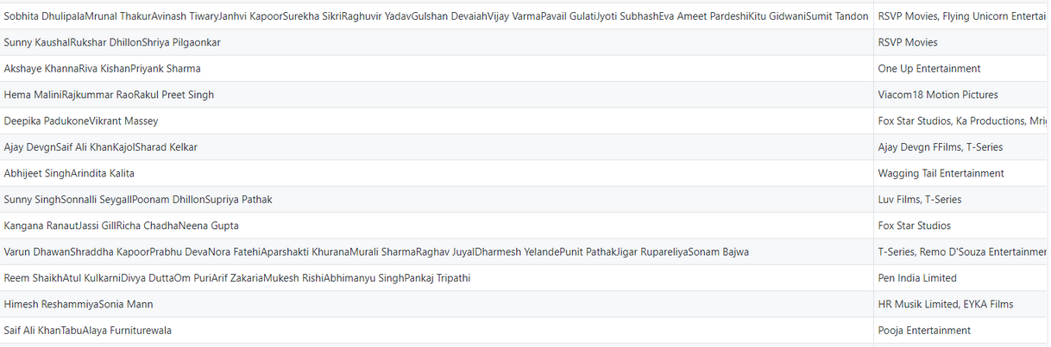
Data Pre-processing
After getting our initial data from web scraping, where we have used Wikipedia
The data here is further pre - processed using panda and numpy.
The pre processed data is displayed in our desired output as shown.

Slide 7
Others
15.8%
Project highlights
Technology
Used
HTML
31.6%
TOOLS USED FOR DEVELOPMENT -
UNCOVERED KEY RESEARCH TRENDS
This solution is carefully analysed and after the evaluation of the possible solutions, the most feasible solution for this project is identified and selected, so the project turns to be cost-effective, vital and practical.
a Operating System : Windows
b Front End :HTML, CSS, JavaScript , BootStrap
c Back End : Python,Django,SQLite
d Server :Apache Tomcat Server
e Technology: Machine learning , Web Development.
Python
42.1%
JS
10.5%
Project Guide :
Prof. Girijesh Mishra
BBD-ITM
Department of Information Technology
January 15,2021

Slide 8
Contributors of the Project
Data collection(Satyam)
Data preprocessing (Ankit)
Front end (Alisha and Harshit and Abhishek)
Backend (Satyam)
API(Satyam)
Project Guide :
Prof. Girijesh Mishra
BBD-ITM
Department of Information Technology
January 15,2021

